Slide 1


Introduction
﻿
﻿
City of Renton - 2024 Budget Survey

Slide 2
Study Background and Objectives
The 2024 survey effort is the City of Renton’s first city-wide budget survey. The objectives of this survey were to:
Gain knowledge of residents’ perceptions about the city​
Understand community priorities and expectations regarding city services​
Support decision making for the upcoming budget process
﻿
The Renton Budget Survey provides a statistically reliable tool which will be used to help the city plan and make resource allocation decisions, assist with program improvement, and inform policy makers on opinions of the general population. The survey addresses the following topics:
Ranking budget priorities
Resident opinions on the biggest issue(s) facing the city
Measuring how well Renton's budget priorities align with residents' vision and values for the city's future.
Residents' attitudes toward taxation levels as it relates to services provided
Residents' attitudes toward funding specific efforts related to human services, parks, and public safety
The condition and availability of city-owned facilities
Demographics
Study questions or want more info?
Contact Raevel Chea at
rchea@rentonwa.gov
City of Renton - 2024 Budget Survey

Slide 3
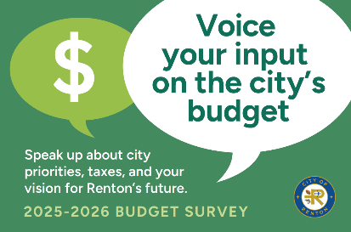
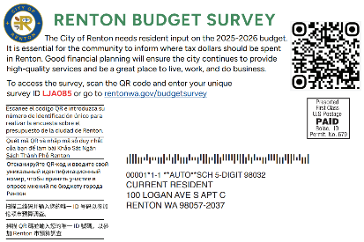
Survey Methodology
The sample frame was composed of a list of all addresses in Renton—as defined by a shape file—including those indicating that post office boxes are the only way they get mail. ReconMR did a two-part sample pull to increase representation of difficult-to-reach populations.
The first sample pull was a random address-based sample of 8,000 residential addresses within city limits. Households that participated in the recent 2023 Community survey effort. were excluded.
The second sample pull was a random address-based sample of 4,500 residential addresses from within census blocks containing a high percentage of difficult-to-reach populations.
All sampled records were run against a database and appended, where available, with a cell phone number, landline number and email address.
All addresses received a post-card inviting residents to participate online. Emails and MMS text messages were sent to all records with a valid email or cell phone number. Finally, follow-up phone calls were made to non-responders.
Three weeks into data collection the survey was opened up to the general public and the city promoted the survey via social media and other outreach methods.
﻿
Study questions or want more info?
Contact Raevel Chea at
rchea@rentonwa.gov
City of Renton - 2024 Budget Survey

Slide 4
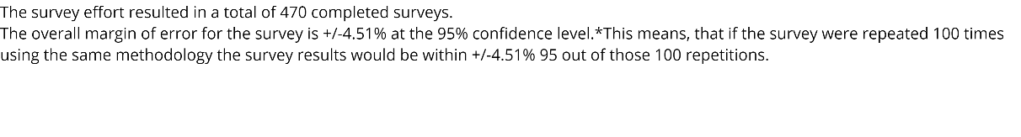
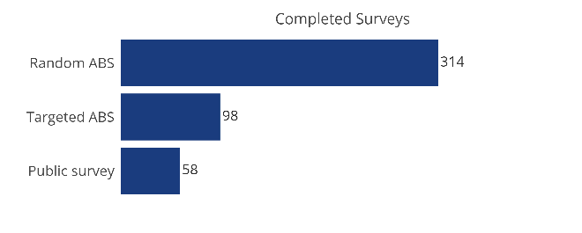
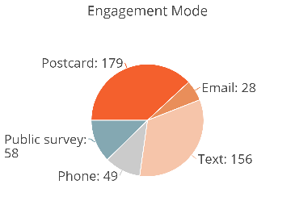

Results
A 'converted respondent' is an individual who received a call from an interviewer and did not want to take the survey over the phone. However, they agreed to confirm their contact information and received an SMS or an email containing a unique link allowing them to participate online.
Study questions or want more info?
Contact Raevel Chea at
rchea@rentonwa.gov
City of Renton - 2024 Budget Survey

Slide 5
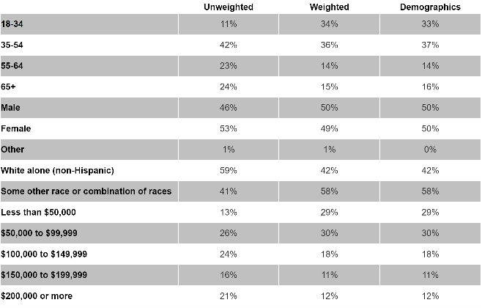
Demographics and Weighting
Survey data are not perfectly representative of the populations of interest; thus, the data were weighted based on four demographic factors:
Age
Gender
Race
Income
﻿
The tables to the right provide the unweighted and weighted proportions compared to the population data.
Age
Gender
Race
Income
Race from Decennial Census Table P1
Income from 2021: ACS 1-Year Estimates Subject Table S1901
Age within gender from 2021: ACS 1-Year Estimates Subject Tables S0101
﻿
Study questions or want more info?
Contact Raevel Chea at
rchea@rentonwa.gov
City of Renton - 2024 Budget Survey
UNWEIGHTED
wEIGHTED
Population

Slide 6
Reporting Conventions
Unless otherwise noted, weighted data is used in this report.
The following notes describe the reporting conventions used in this report.
The report is organized by major topic area. Tables and charts provide supporting data.
Information about the overall results for each topic area is generally reported first, followed by relevant, statistically and practically significant differences between years and/or key subgroups. The probability level for determining statistical significance is less than .05 (unless otherwise noted). When testing for significant associations and/or differences between groups in the base, unweighted sample sizes should be used. When significant differences (assuming a 95 percent confidence level) were observed, they are noted in the written text of the report and bold-faced and notated in the accompanying tables.
Except where noted, tables and charts provide information from respondents who offered a valid opinion to a question. “Don’t know” and “Refused” are counted as missing values unless “Don’t know” is a valid or meaningful response.
In most charts and tables, unless otherwise noted, column percent is used. Percent is rounded to the nearest whole number. Some columns may sum to more or less than 100% due to rounding, the permissibility of multiple responses for specific questions, or based on presentation of abbreviated data.
﻿
Study questions or want more info?
Contact Raevel Chea at
rchea@rentonwa.gov
City of Renton - 2024 Budget Survey

Slide 7
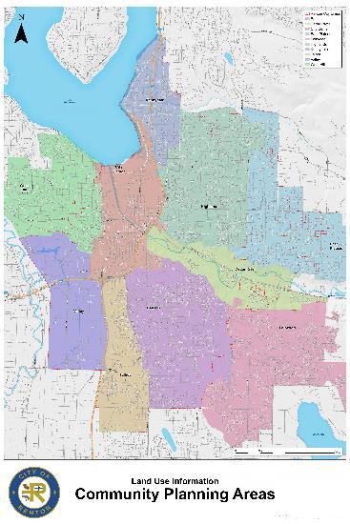
Community Planning Areas
﻿
﻿
Study questions or want more info?
Contact Raevel Chea at
rchea@rentonwa.gov
City of Renton - 2024 Budget Survey

Slide 8
Budget Priorities
﻿
﻿
City of Renton - 2024 Budget Survey

Slide 9
Introduction
﻿
This survey used a series of questions to determine resident priorities for Renton's 2025-26 budget. The first exercise employed the Q-Sort method to gauge the relative importance of various budget items. Subsequent questions assessed how well each budget item aligns with respondents' vision for Renton and the progress observed over the past 5-10 years. The resulting data from these questions can be viewed individually, or collectively in a quadrant chart. The quadrant chart visualizes areas that are highly important, well-aligned with residents' vision, but have seen slow or minimal progress.
﻿
Budget Priority Items
﻿
Increase safety and security in community
Expand and enhance traffic signals and intersections
Increase bike lanes
Expand network of trails
Enforce a high standard of property maintenance
Encampment and graffiti cleanup
Expand open space
Install electric vehicle charging stations
Fund services that address mental and behavioral health, addiction, and food security for those in need
Maintain and improve existing parks, trails, and public outdoor spaces
Increase access to city staff and facilities
﻿
﻿
Study questions or want more info?
Contact Raevel Chea at
rchea@rentonwa.gov
City of Renton - 2024 Budget Survey

Slide 10
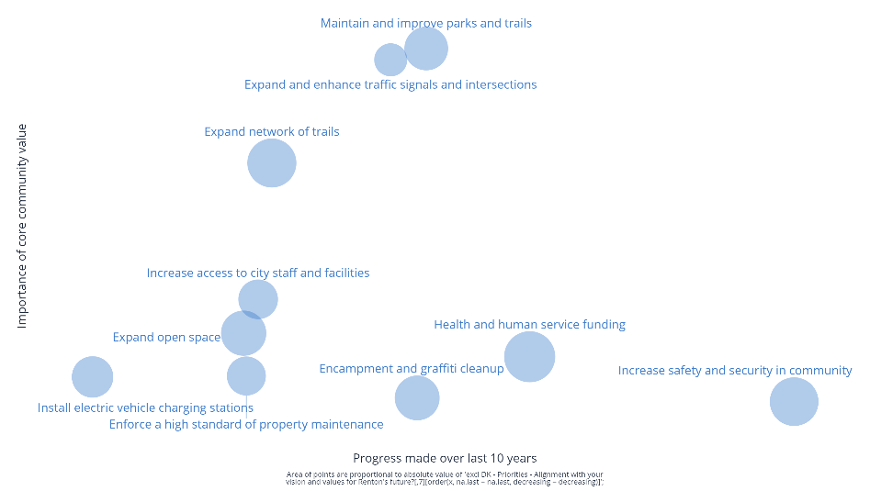
Quadrant Chart - Importance, Progress, and Alignment
﻿
The areas where Renton can improve:
﻿
Increasing safety and security in the community
﻿
Funding services that address mental health, addiction, and food security for those in need
﻿
Encampment and graffiti cleanup
﻿
﻿
Size of bubble indicates how well each item aligns with respondents' vision and values for Renton's future
Bigger bubble = more aligned.
Low Importance / High Progress: Maintain
High Importance / High Progress: Maintain
﻿
Better Progress
﻿
Low Importance / Low Progress: Monitor
More Important
High Importance / Low Progress: Improve
﻿
Study questions or want more info?
Contact Raevel Chea at
rchea@rentonwa.gov
City of Renton - 2024 Budget Survey

Slide 11
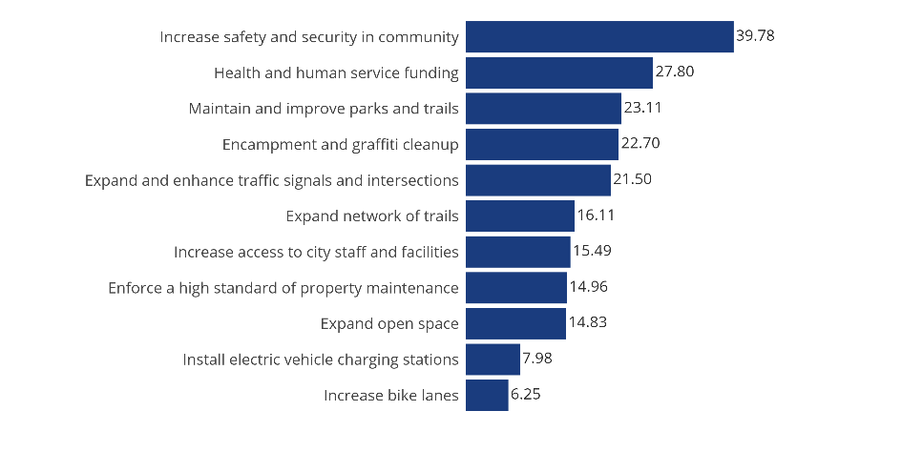
Importance Scores
﻿
Most important priorities for respondents:
Public safety
Health and human services
Park maintenance and improvement
City clean-up
﻿
How to interpret importance scores:
An “importance score” is calculated for each budget item and together all the scores add up to 100. This metric shows how much more important any one budget item is from another, in the opinions of respondents.
﻿
For example, 'Health and human service funding' has an importance score of 28, and 'Expand open space' has a score of 14. Comparing these scores, we can say that Renton residents, on average, think funding health and human service ' is 2x more important than expanding open space.
Select all that are important to you. Select the most important. Select the least important.
[Chart show importance scores, which are derived from these three questions]
﻿
Study questions or want more info?
Contact Raevel Chea at
rchea@rentonwa.gov
City of Renton - 2024 Budget Survey

Slide 12
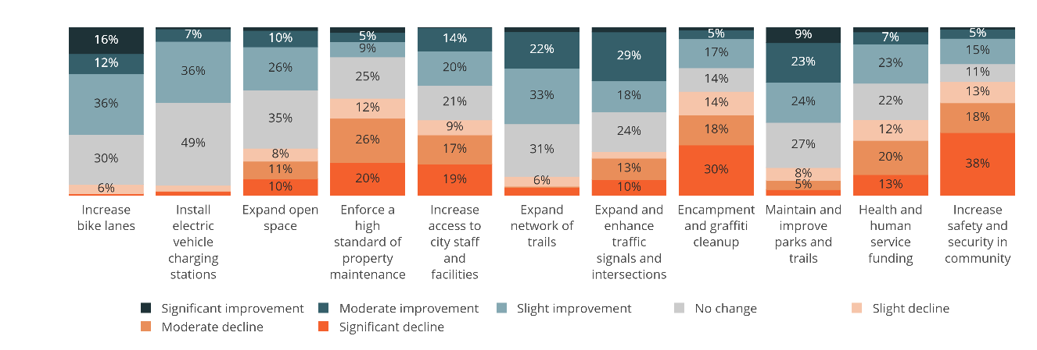
Progress Toward Priorities
﻿
How would you rate the progress made over the last 5-10 years by the city of Renton concerning each of the following services / initiatives?
Low Importance
High Importance
﻿
Study questions or want more info?
Contact Raevel Chea at
rchea@rentonwa.gov
City of Renton - 2024 Budget Survey

Slide 13
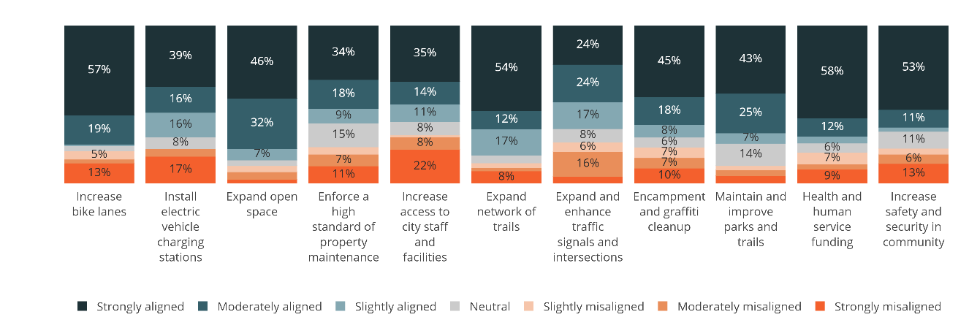
Alignment with Priorities
﻿
Next, thinking about the same services and initiatives, please tell us how well each one aligns with your vision and values for Renton's future?
Low Importance
High Importance
﻿
Study questions or want more info?
Contact Raevel Chea at
rchea@rentonwa.gov
City of Renton - 2024 Budget Survey

Slide 14
Honest Opinions - Data from Open Ended Questions
﻿
﻿
Study questions or want more info?
Contact Raevel Chea at
rchea@rentonwa.gov
City of Renton - 2024 Budget Survey

Slide 15
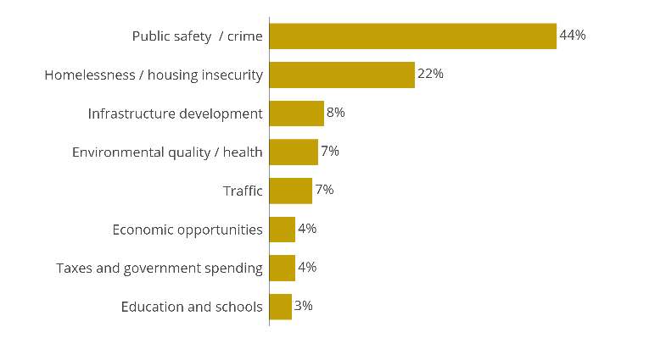
Biggest Problems Facing Renton
﻿
Respondents were asked to write in the biggest problem facing Renton that the City should focus on short-term. The most common themes were concerns about public safety, homelessness, and housing insecurity.
Thinking about the budget building process what is the biggest problem facing Renton that you feel the City should focus on over the next two years?
[coded responses from open ended question]
﻿
Study questions or want more info?
Contact Raevel Chea at
rchea@rentonwa.gov
City of Renton - 2024 Budget Survey

Slide 16
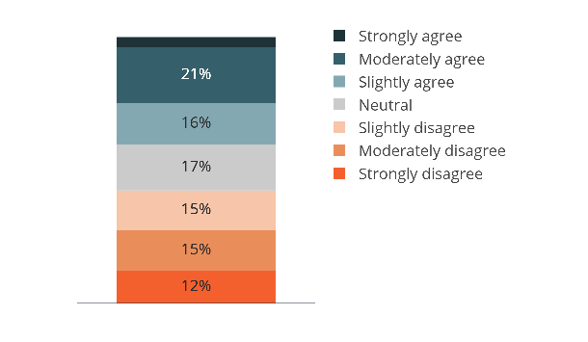
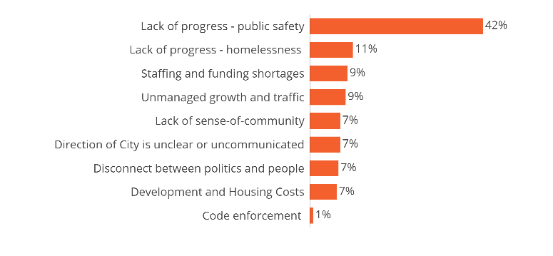
Focusing and Making Progress on the Right Things
﻿
41% of respondents agree that the City is focusing on and making progress on the right. Respondents who didn't strongly agree were asked to clarify their stance; citing insufficient progress on public safety and homelessness, staffing and funding shortages, unmanaged growth, and a disconnect between political agendas and residents' needs.
Based on what you have seen, heard, read, or experienced in the past few years, please indicate how much you agree or disagree that the City of Renton is focusing and making progress on the right things.
Please explain in 1-2 sentences why you believe the City of Renton is not adequately focused or making progress on the right things.
[coded responses from open ended question]
﻿
Study questions or want more info?
Contact Raevel Chea at
rchea@rentonwa.gov
City of Renton - 2024 Budget Survey
 | %
Lack of progress - public safety | 42% ↑
Lack of progress - homelessness | 11%
Unmanaged growth and traffic | 9%
Development and Housing Costs | 7% ↓
Staffing and funding shortages | 9%
Lack of sense-of-community | 7%
Code enforcement | 1% ↓
Direction of City is unclear or uncommunicated | 7%
Disconnect between politics and people | 7% ↓
NET | 100% ↑
OPEN - Why do you believe the City of Renton is not adequately focused or making progress on the right things. - Categorized1 SUMMARY
sample size = 228; total sample size = 470; 242 missing; 95% confidence level

Slide 17
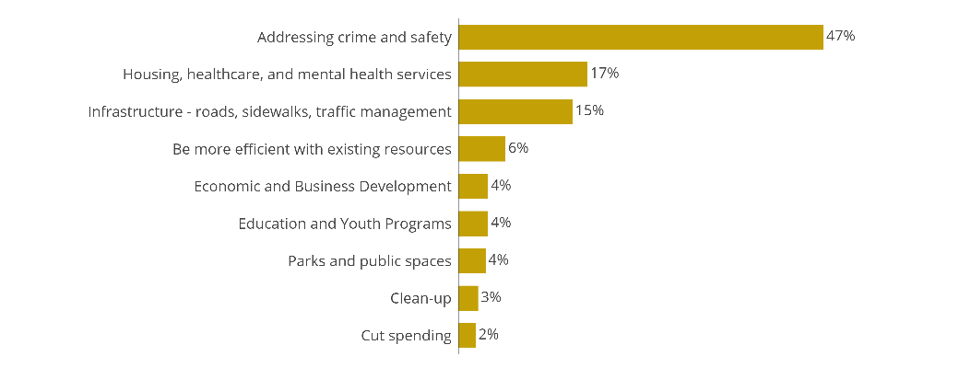
Resource Allocation
﻿
Respondents were asked where the City should allocate more resources. Common themes focused on crime and public safety, infrastructure development and maintenance, and services for those with limited access to healthcare and housing.
Please tell us where you think the city should allocate more resources.
[coded responses from open ended question]
﻿
Study questions or want more info?
Contact Raevel Chea at
rchea@rentonwa.gov
City of Renton - 2024 Budget Survey

Slide 18
Attitudes Towards Spending
﻿
﻿
Study questions or want more info?
Contact Raevel Chea at
rchea@rentonwa.gov
City of Renton - 2024 Budget Survey

Slide 19
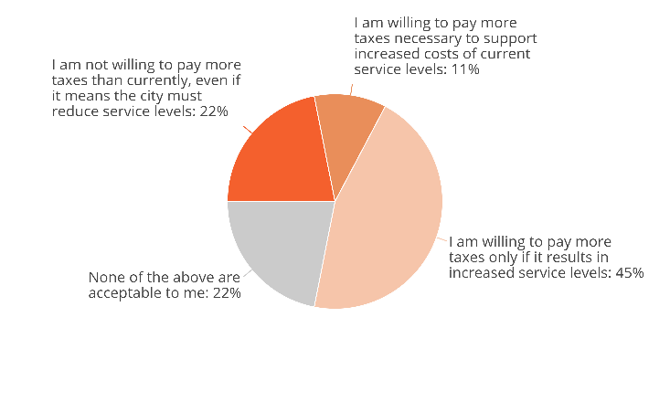
General Willingness to Pay Taxes
﻿
Nearly half of respondents are willing to pay more taxes, but only if it results in increased service levels.
﻿
More willing to pay a higher tax rate (only if it results in increased service levels)
Those with a household income greater than 200k
Which of these statements comes close to your view?
﻿
Study questions or want more info?
Contact Raevel Chea at
rchea@rentonwa.gov
City of Renton - 2024 Budget Survey

Slide 20
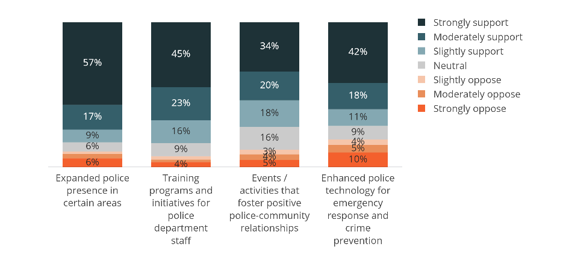
Police Funding
﻿
83% of respondents support expanded police presence and 84% support funding training programs for Police Department staff. 72% support events that foster positive relationships between the Police Department and the community. While 72% support enhanced police technology, this topic garnered the most opposition, with 19% of respondents opposing funding for this measure.
How much do you support or oppose using City tax dollars to fund the following safety and security measures?
﻿
Study questions or want more info?
Contact Raevel Chea at
rchea@rentonwa.gov
City of Renton - 2024 Budget Survey

Slide 21
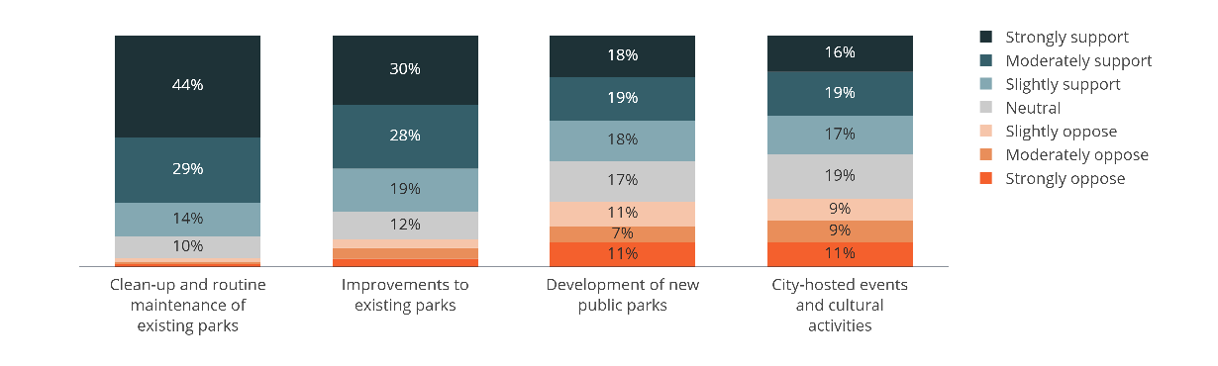
Parks Funding
﻿
87% of respondents support using City tax dollars to fund clean-up and maintenance of existing parks in Renton. 77% support funding for improvements to existing parks. While more than half support development of new parks and city-hosted events, these initiatives are more polarizing, with 20-30% of respondents opposing these funding measures.
How much do you support or oppose using City tax dollars to fund the following ?
﻿
Study questions or want more info?
Contact Raevel Chea at
rchea@rentonwa.gov
City of Renton - 2024 Budget Survey

Slide 22
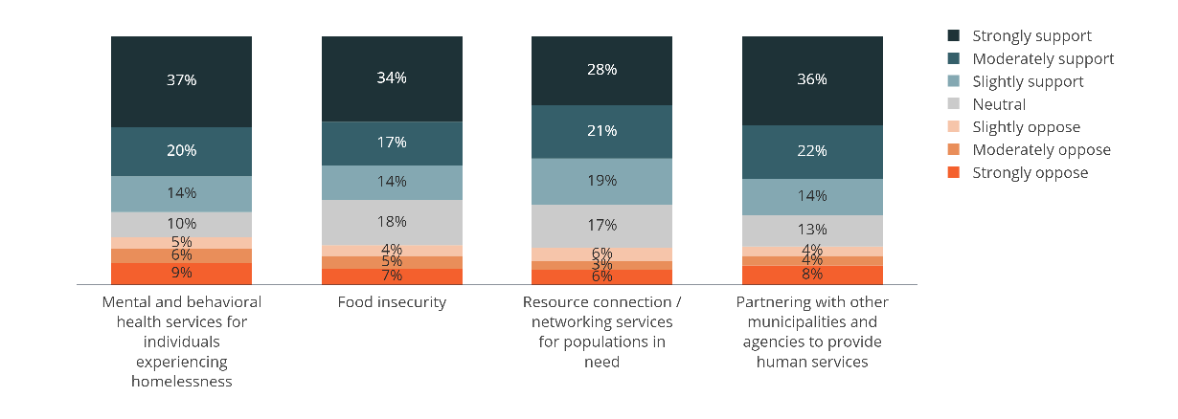
Health & Human Service Funding
﻿
Across the board, 65-70% of respondents support using City tax dollars to fund services that address mental & behavioral health, food insecurity, and resource connection. Respondents support the idea of partnering with other agencies and municipalities to provide these health and human services.
How much do you support or oppose using City tax dollars to fund efforts that address the following challenges?
﻿
Study questions or want more info?
Contact Raevel Chea at
rchea@rentonwa.gov
City of Renton - 2024 Budget Survey

Slide 23
Public Safety
﻿
﻿
Study questions or want more info?
Contact Raevel Chea at
rchea@rentonwa.gov
City of Renton - 2024 Budget Survey

Slide 24
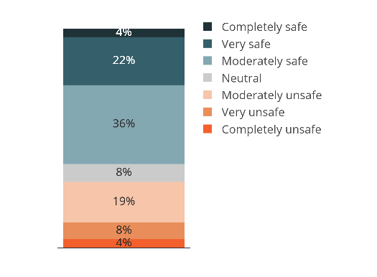
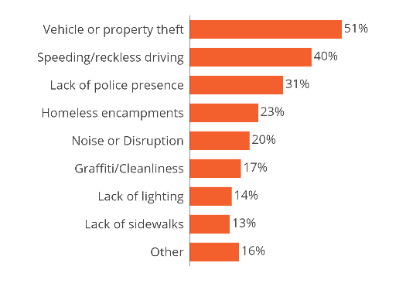
Neighborhood Safety - Overall
﻿
Two-thirds of respondents feel safe in their residential neighborhood. Those who selected anything less than 'completely safe' were asked to indicate why. Top concerns in residential neighborhoods are theft, reckless driving, lack of police presence, and encampments.
How safe do you feel in your residential neighborhood?
Please identify the reason(s) for feeling less than completely safe in your residential neighborhood.
﻿
Study questions or want more info?
Contact Raevel Chea at
rchea@rentonwa.gov
City of Renton - 2024 Budget Survey

Slide 25
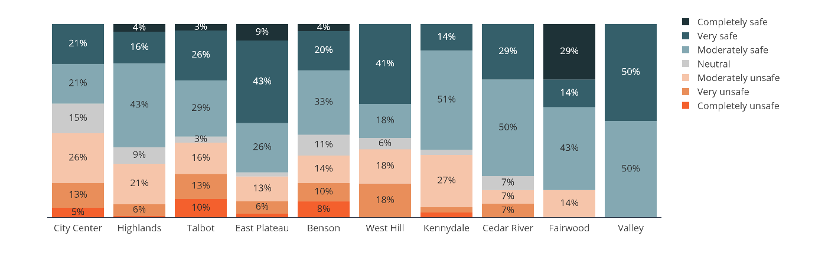
Neighborhood Safety by Comprehensive Planning Area
﻿
East Plateau and Highlands received high neighborhood safety ratings, while City Center receives the lowest.
Due to the limited number of respondents in Valley (n=2), Fairwood (n=7), Cedar River (n=14), and West Hill (n=17), conclusions for these planning areas are not statistically reliable.
How safe do you feel in your residential neighborhood?
﻿
Study questions or want more info?
Contact Raevel Chea at
rchea@rentonwa.gov
City of Renton - 2024 Budget Survey

Slide 26
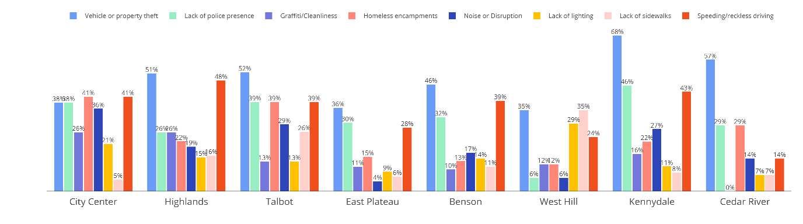
Reasons for Feeling Less than Completely Safe by Planning Area
﻿
Theft and reckless driving are generally seen as the top two issues across most planning areas. The most notable exception is homeless encamplents which are a commonly mentioned issue in City Center, Talbot and Cedar River.
﻿
Valley (n=2) and Fairwood (n=7) are not shown in the chart below due to the small sample sizes.
﻿
Study questions or want more info?
Contact Raevel Chea at
rchea@rentonwa.gov
City of Renton - 2024 Budget Survey

Slide 27
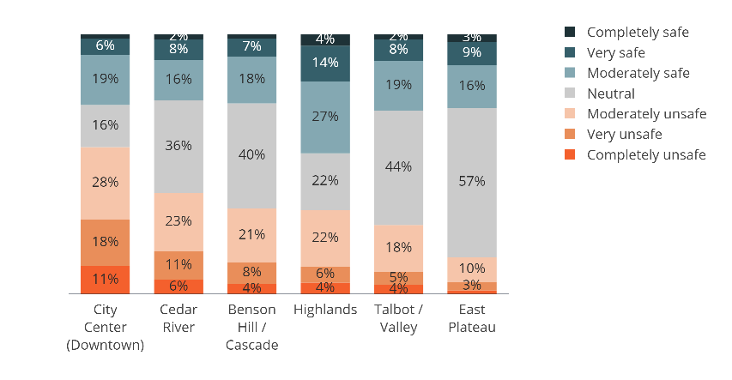
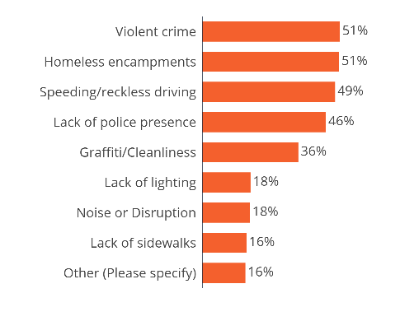
Safety in Commercial Areas
﻿
Respondents were more likely to report feeling unsafe in City Center, Cedar River, and Benson Hill / Cascade. The predominant factors driving safety concerns are encampments, violent crime, reckless driving, and an overall lack of police presence. These are the top four safety concerns for all six non-residential areas asked about in the survey.
Please rate how safe you feel in each of the following commercial and non-residential areas.
Please identify the reason(s) for feeling less than completely safe in the commercial and non-residential areas of Renton.
﻿
Study questions or want more info?
Contact Raevel Chea at
rchea@rentonwa.gov
City of Renton - 2024 Budget Survey

Slide 28
Condition of City Property
﻿
﻿
Study questions or want more info?
Contact Raevel Chea at
rchea@rentonwa.gov
City of Renton - 2024 Budget Survey

Slide 29
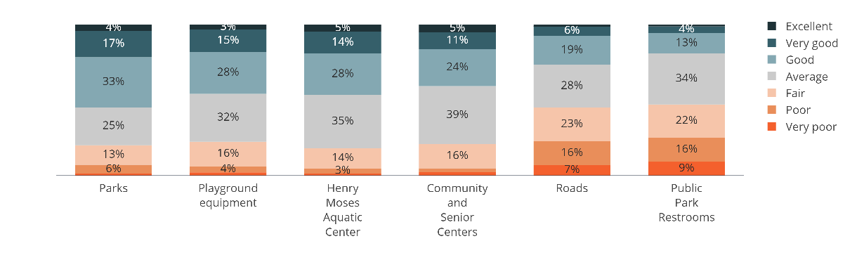
Overall Condition
﻿
When it comes to the overall condition of city facilities, public park restrooms and roads received the lowest ratings, with nearly half of respondents giving below average ratings.
How would you rate the overall condition of each of the following city infrastructure?
﻿
Study questions or want more info?
Contact Raevel Chea at
rchea@rentonwa.gov
City of Renton - 2024 Budget Survey

Slide 30
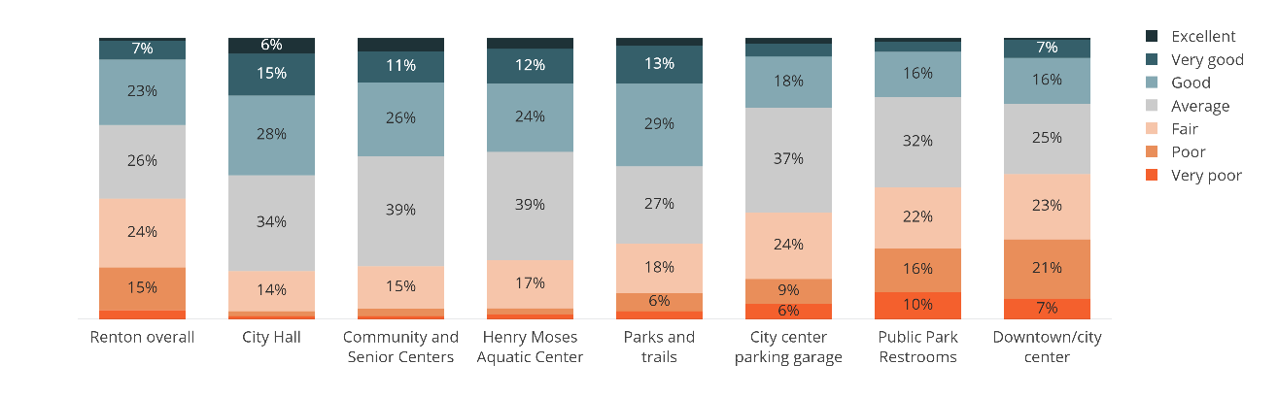
Cleanliness
﻿
Downtown Renton received the lowest cleanliness ratings, followed by public park restrooms and the City Center parking garage.
43% of respondents rated Renton's overall cleanliness as below average.
How would you rate the cleanliness of each of the following?
﻿
Study questions or want more info?
Contact Raevel Chea at
rchea@rentonwa.gov
City of Renton - 2024 Budget Survey

Slide 31
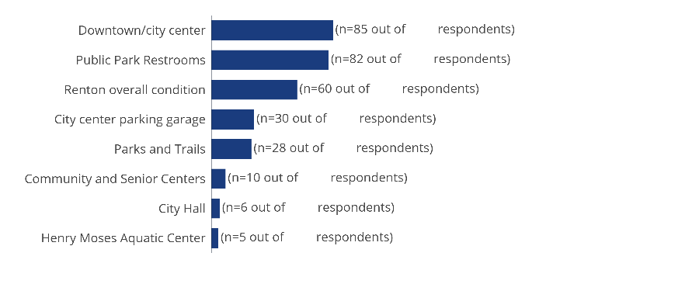
Making Improvements - Budget Allocation Attitudes
﻿
Respondents who rated the cleanliness of a City facility as "poor" or "very poor" were asked if they would support allocating additional budget to improve that location. The facilities with the highest proportion of low cleanliness ratings were Renton overall, City Center, and public park restrooms. The majority of respondents dissatisfied with these locations expressed support for increased funding to enhance their cleanliness and maintenance.
Would you support additional budget to be allocated to improve this location?
(Showing # of respondents who selected "Yes")
132
119
87
68
44
18
14
19
﻿
Study questions or want more info?
Contact Raevel Chea at
rchea@rentonwa.gov
City of Renton - 2024 Budget Survey

Slide 32
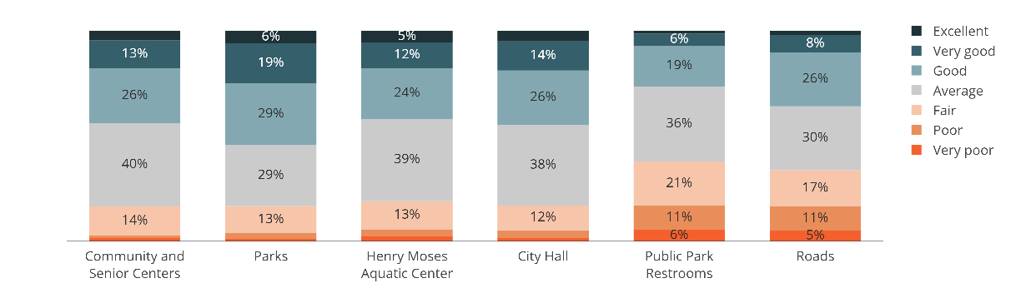
Convenience and Availability
﻿
Roads and public park restrooms received the lowest ratings for convenience and availability.
Think about the ease or convenience factor of using the following city facilities.
How would you rate the convenience / availability of these city facilities?
﻿
Study questions or want more info?
Contact Raevel Chea at
rchea@rentonwa.gov
City of Renton - 2024 Budget Survey

Slide 33
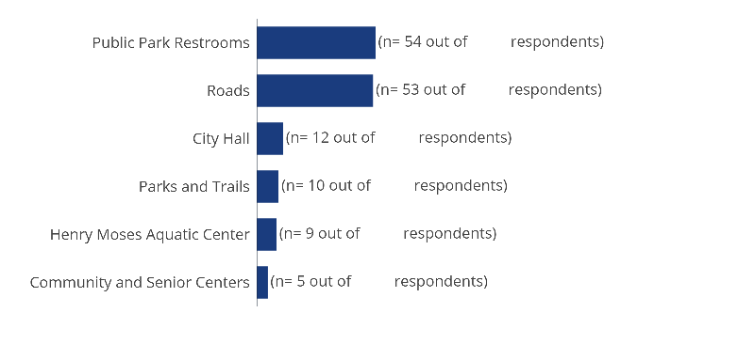
Improving Availability - Budget Allocation Attitudes
﻿
Respondents who rated the availability of a City facility as "poor" or "very poor" were asked if they would support allocating additional budget to improve the availability of that location. The facilities with the highest proportion of low availability ratings were public park restrooms and roads. The majority of respondents dissatisfied with these locations expressed support for increased funding to enhance their availability and convenience.
Would you support additional budget to improve the availability/convenience of this location?
(Showing # of respondents who selected "Yes")
80
78
25
18
26
13
﻿
Study questions or want more info?
Contact Raevel Chea at
rchea@rentonwa.gov
City of Renton - 2024 Budget Survey

Slide 34
Transportation & Sustainability
﻿
﻿
Study questions or want more info?
Contact Raevel Chea at
rchea@rentonwa.gov
City of Renton - 2024 Budget Survey

Slide 35
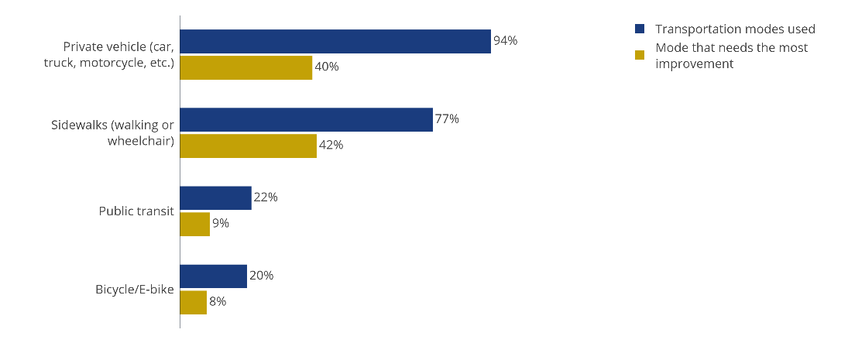
Modes used
﻿
The majority of respondents use a combination of walking and driving a personal vehicle to get around Renton. When asked to select a single mode of transportation they would like to see improved the most, there is equal desire for improvements to sidewalks and roads.
﻿
Study questions or want more info?
Contact Raevel Chea at
rchea@rentonwa.gov
City of Renton - 2024 Budget Survey

Slide 36
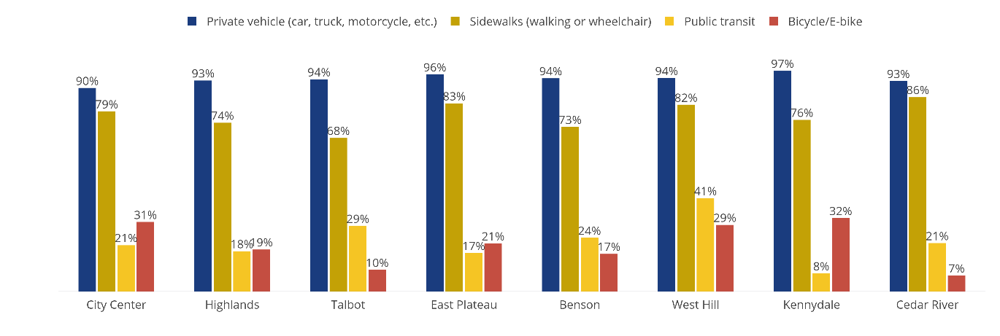
Modes Used by Planning Zone
﻿
The majority of respondents use a combination of walking and driving a personal vehicle to get around Renton. Public transit is most commonly used by residents in West Hill.
Valley (n=2) and Fairwood (n=7) are not shown in the chart below due to the small sample sizes.
﻿
Study questions or want more info?
Contact Raevel Chea at
rchea@rentonwa.gov
City of Renton - 2024 Budget Survey

Slide 37
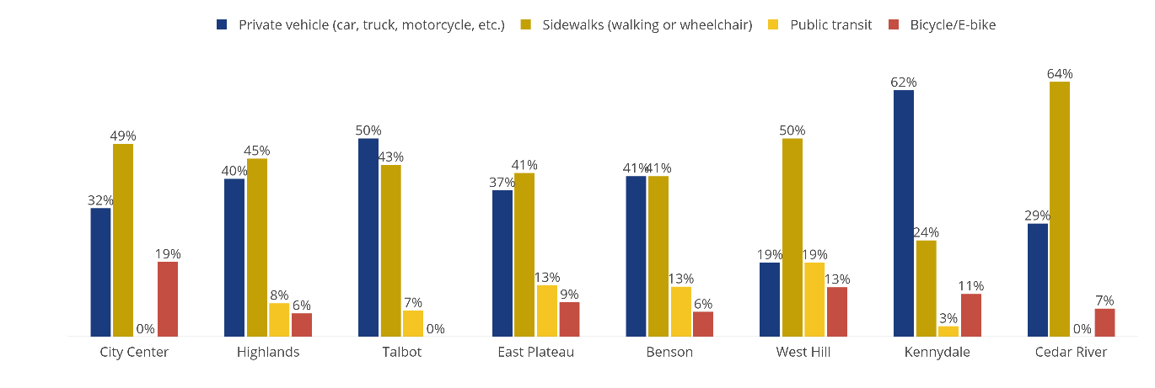
Transportation Improvements by Planning Zone
﻿
Improvements to sidewalks are the most requested transportation improvement across five of the eight planning zones. The notable exception is Kennydale, where nearly two-thirds of residents want to see improvements to streets.
Valley (n=2) and Fairwood (n=7) are not shown in the chart below due to the small sample sizes.
﻿
Study questions or want more info?
Contact Raevel Chea at
rchea@rentonwa.gov
City of Renton - 2024 Budget Survey

Slide 38
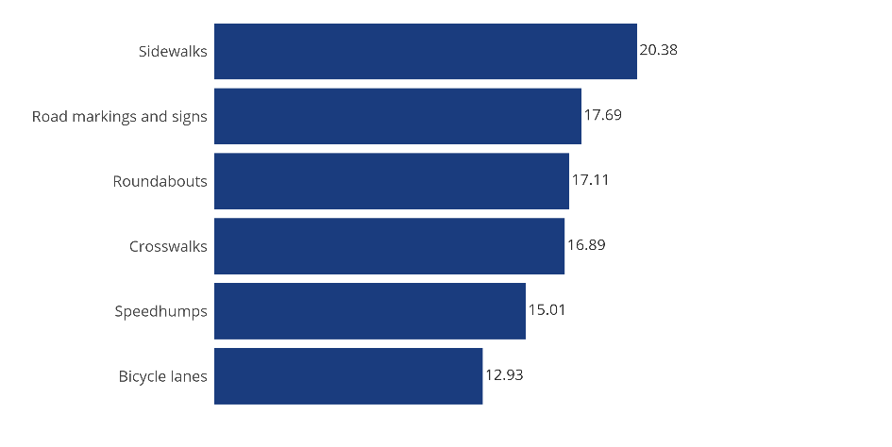
Traffic Safety Initiatives
﻿
There is not much differentiation when it comes to the relative importance of traffic safety measures.
Sidewalks are the most important
Road markings, roundabouts and crosswalks are all similarly important
Speedhumps and bicycle lanes are less important
﻿
How to interpret importance scores:
An “importance score” is calculated for each budget item and together all the scores add up to 100. This metric shows how much more important any one budget item is from another, in the opinions of respondents.
﻿
For information on how this question set was analyzed, see the Introduction of the Budget Priorities section.
﻿
Select all that are important to you. Select the most important. Select the least important.
[Chart show importance scores, which are derived from these three questions]
﻿
Study questions or want more info?
Contact Raevel Chea at
rchea@rentonwa.gov
City of Renton - 2024 Budget Survey
What is this variable? Are these utility score?

Slide 39
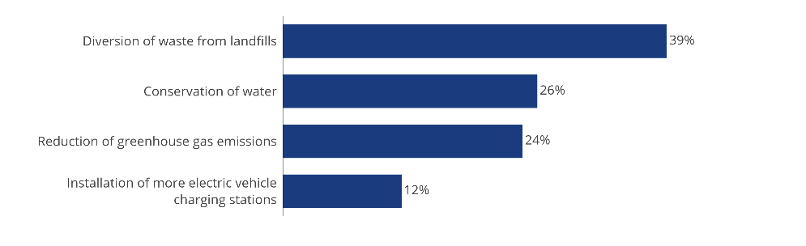
Sustainability Initiatives
﻿
38% of respondents want the City to prioritize waste diversion from landfills, while water conservation is a priority for 26%, and greenhouse gas reduction for 24%. Only 12% believe that installing more EV charging stations should be a priority.
Which of the following sustainability initiatives do you feel should be prioritized?
﻿
Study questions or want more info?
Contact Raevel Chea at
rchea@rentonwa.gov
City of Renton - 2024 Budget Survey

